Slide 1




KFA CHATBOT: DEVELOPMENT AND DEPLOYMENT
FROM DATA COLLECTION TO MODEL DEPLOYMENT
NAMSAM KOYU RAI SHWOPNIL NAKARMI

Slide 2
INTRODUCTION
This AI-powered chatbot is an intelligent virtual assistant designed specifically for KFA Business School. Unlike basic chatbots limited to predefined responses, it leverages machine learning (including neural networks and NLP) to understand natural language queries, maintain conversation context, and provide accurate, personalized answers about programs, admissions, and campus services. It combines multiple AI techniques for robust performance, ensuring students and staff get human-like interactions with instant, 24/7 support.
Key Features:
Natural Language Understanding – Uses NLP & ML to interpret varied questions
Context-Aware Responses – Maintains conversation flow for follow-ups
Multi-Model AI – Combines Neural Networks, LSTM, and XGBoost for accuracy
Dynamic Fallbacks – Smart suggestions when unsure
Data-Driven Training – Optimized with SMOTE & TF-IDF for real-world queries

Slide 3
Objective:
To enhance student engagement, automate administrative support, and provide 24/7 instant assistance for admissions, academics, fees, and campus services.
Scope:
Admissions: Program details, eligibility, application status.
Academics: Schedules, exams, assignments, LMS support.
Student Services: Fees, scholarships, campus facilities.
Career Support: Internships, placements, resume tips.
Integration: Website, WhatsApp, LMS, CRM.
AI Features: NLP, multilingual, human handoff.
Impact: Faster responses, reduced workload, improved student experience.

Slide 4
OLD MODEL VS. NEW MODEL
ASPECT | OLD MODEL | NEW MODEL
Uses | General Purpose | KFA Inquiry Purposes only
Description | FAQ lookup tool—rigid and limited to predefined Q&A pairs. | Smart assistant—understanding intent, maintaining context, and improving with ML.
Matching questions | Exact keyword matching | ML-powered intent detection (understands variations)

Slide 5
Responses | Fixed replies (no follow-ups) | Context-aware
Fallback Handling | "I don’t understand" | Smart suggestions (e.g., "Try asking about MBA fees")
Adaptability | Manual updates needed | Learns from data (generalizes to new queries)
Best for | Simple FAQs | Dynamic conversations (e.g., admissions, support)

Slide 6
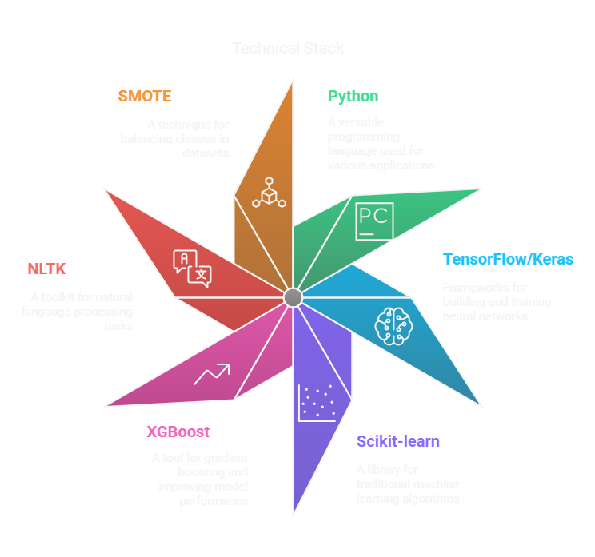
TECHNOLOGIES USED

Slide 7

DATA COLLECTION
1. Dataset Overview
Our dataset is a *JSON file* containing intents, patterns, responses, and context for training a chatbot. It is structured and well-organized, making it suitable for intent classification and response generation.
3. Dataset Structure
The dataset is structured as a *JSON object* with a single key "intents", which contains an array of intent objects. Each intent object has the following keys:
tag → A unique identifier for the intent (e.g., greeting, mba_program).
patterns → Example user queries (different ways to ask the same question).
responses → Predefined bot replies for each intent.
context (optional) → Helps manage follow-up questions (e.g., mba_details).
2. Dataset Size
Number of Intents: 24 (e.g., greeting, goodbye, about_kfa, mba_program, etc.).
Total Patterns: ~200 (example user queries).
Total Responses: ~100 (bot responses).
File Size: Depending on formatting, the JSON file is likely 10–20 KB* in size.

Slide 8
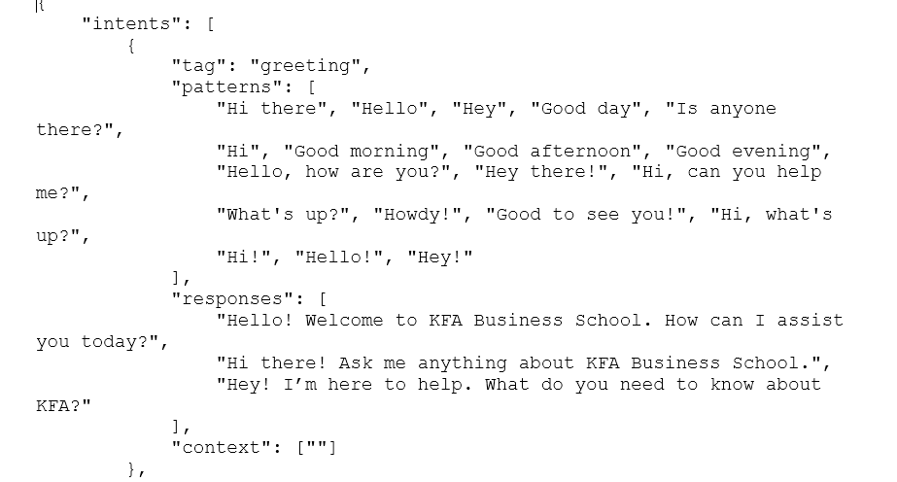

Slide 9
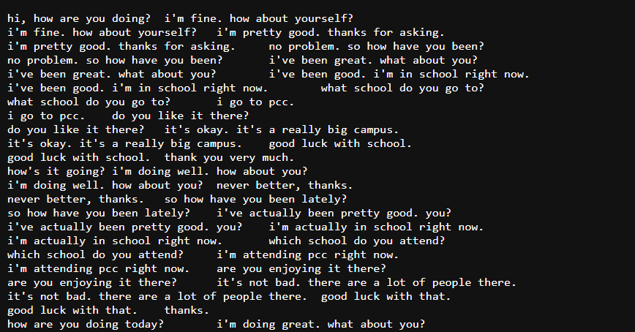
Previous dataset

Slide 10
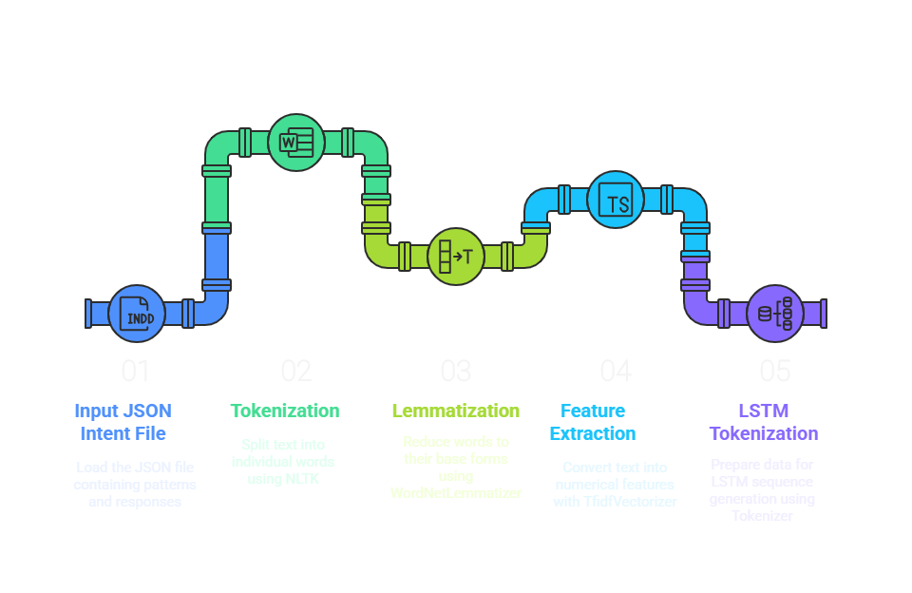
DATA PREPROCESSING FLOW:

Slide 11
Text Normalization
Converts all text to lowercase
Removes special characters/punctuation
Handles contractions (e.g., "can't" → "cannot")

Slide 12
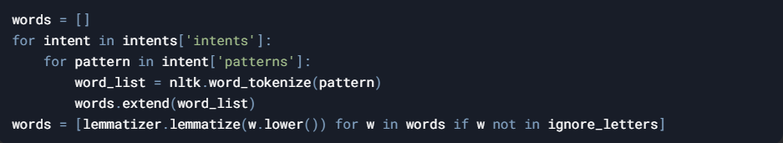
Advanced Tokenization
Splits text into meaningful units (words/sentences)
Preserves domain-specific terms (e.g., "MBA", "BBA")
Handles edge cases (dates, numbers, abbreviations)
Lemmatization
Uses WordNet lexicon for accurate base forms
Handles irregular verbs (e.g., "went" → "go")
More accurate than stemming for educational content

Slide 13
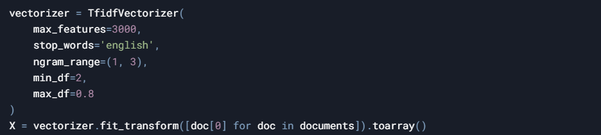
Feature Engineering
TF-IDF: Captures term importance in documents
N-grams: Preserves phrase context (1-3 words)
Sequence Encoding: For LSTM models (pad_sequences)
Quality Control
Empty string removal
Stop word filtering (configurable)
Minimum length requirements

Slide 14
MODEL ARCHITECTURE:
"MULTI-MODEL AI ENGINE"
Neural Network
Long Short-Term Memory
XGBoost
Random Forest

Slide 15
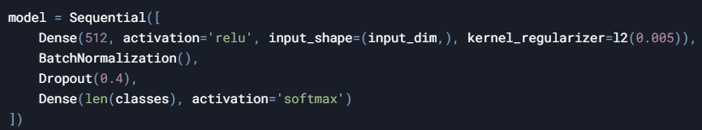
Neural Network (Dense Model)
Structure:
3 hidden layers (512 → 256 → 128 nodes)
Dropout layers (40%) to prevent overfitting
Strengths:
Best for general intent classification
Handles noisy/ambiguous queries well

Slide 16
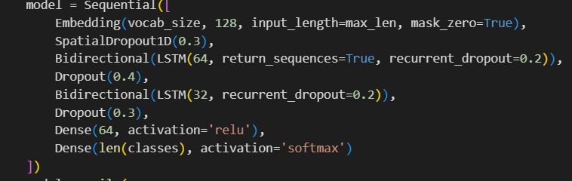
Bidirectional LSTM
Key Features:
Processes word sequences (past + future context)
Embedding layer for semantic understanding
Optimized For:
Complex/long-form questions
Contextual follow-ups

Slide 17
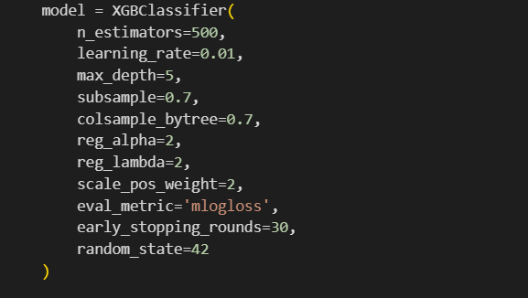
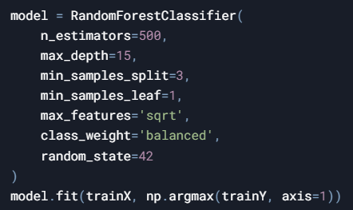
XGBoost (Tree-Based Model)
Advantages:
Handles structured TF-IDF features efficiently
Automatic feature importance ranking
Use Case:
Fast predictions for common queries
Fallback when NN/LSTM confidence is low
Random Forest
Role:
Secondary fallback model
Robust to overfitting
Specialization:
Rare/intent classification

Slide 18
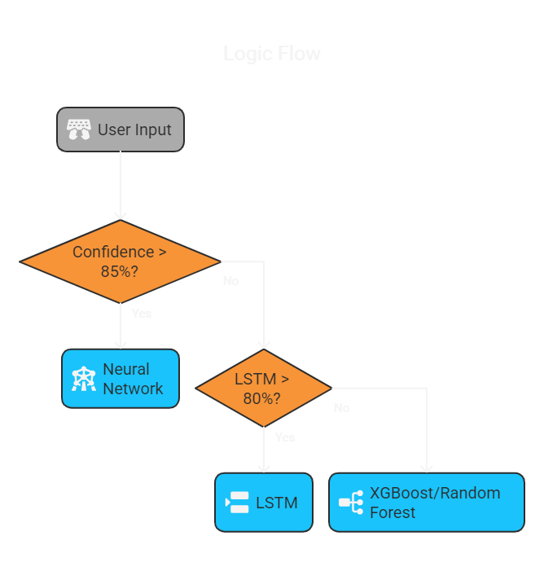
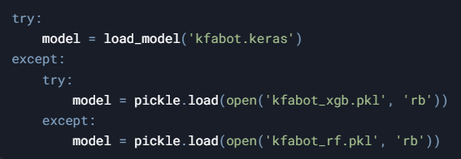
Hybrid Decision System

Slide 19

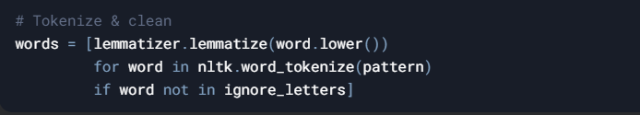
TRAINING THE MODEL
TRAINING DATA:
Data Preparation
Source:
dataset.json with patterns (questions) and responses
Preprocessing:
Output: words.pkl (vocabulary), classes.pkl (intent tags)

Slide 20
Feature Extraction
TF-IDF (for NN/XGBoost/RF):
Converts text to numerical features (1-3 word phrases)
Sequences (for LSTM):
Converts text to padded number sequences

Slide 21
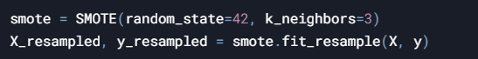
Class Balancing
SMOTE Oversampling:
Generates synthetic samples for rare intents
Class Weights:
Adjusts model focus during training

Slide 22
Model Training
Multi-Model Approach:
All models trained on same preprocessed data:
Key Parameters:
Early stopping, learning rate reduction
Stratified train-test split (80-20)

Slide 23
Model Selection
Performance Metrics:
Best Model Saved:

Slide 24
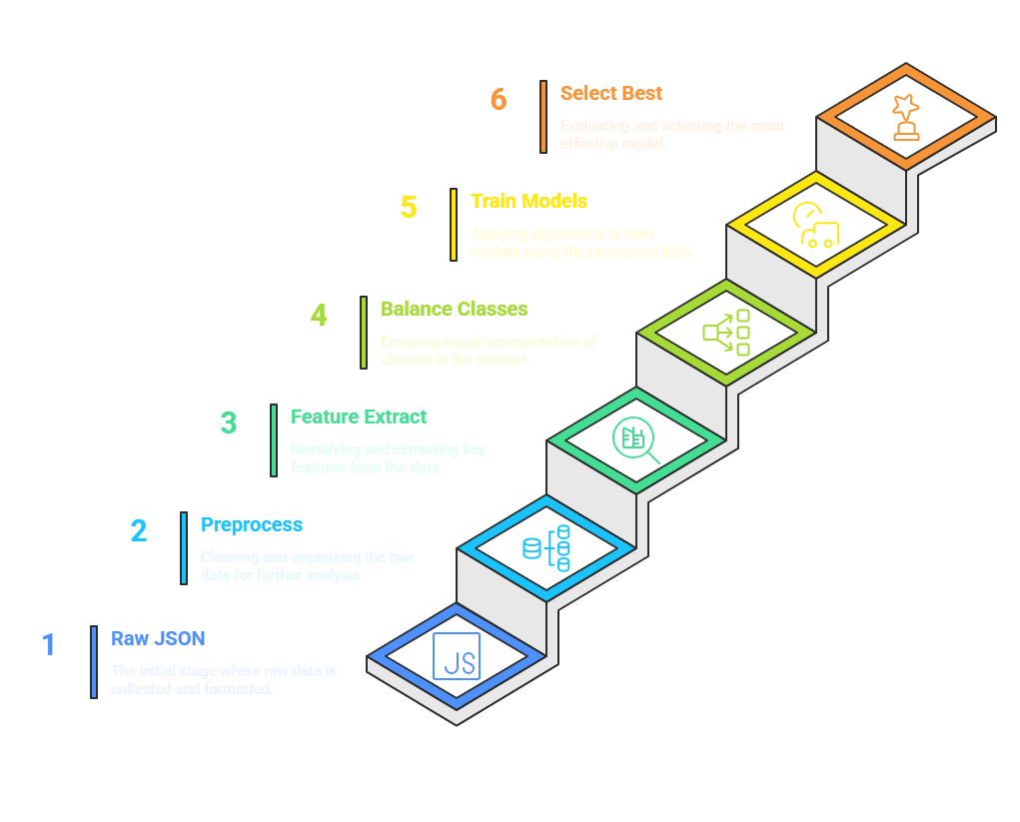
Training Process Overview

Slide 25

Capabilities of the chatbot
Dynamic Confidence Threshold
Context-Aware Dialogues
Multi-Layer Fallback System
Class Imbalance Handling

Slide 26
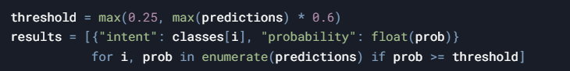
Dynamic Confidence Thresholding:
Code Implementation:
Why It Matters:
Rejects low-confidence predictions (avoids nonsense answers)
Adjusts to input difficulty (strict for ambiguous queries)
Context-Aware Dialogues:
Code Implementation:
Use Case:
Handles follow-ups like "What about fees?" after program queries
Maintains conversation state without manual coding

Slide 27
Multi-Layer Fallback System:
Code Flow:
Try primary model (Keras NN)
Fallback to XGBoost → Random Forest
Final fallback: Curated responses
Class Imbalance Handling
Two-Pronged Approach:
SMOTE: Generates synthetic training samples

Slide 28
Class Imbalance Handling:
Two-Pronged Approach:
SMOTE: Generates synthetic training samples
Class Weights: Boosts focus on rare intents during training

Slide 29

Model Deployment & Serving
Model Serialization
Production Loading
Prediction Pipeline
Output Handling

Slide 30
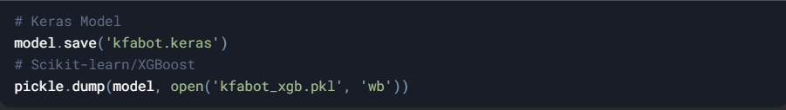
Model Serialization
Code Implementation:
Saved Assets:
Trained model weights
Tokenizers (words.pkl, classes.pkl)
TF-IDF vectorizer (tfidf_vectorizer.pkl)

Slide 31
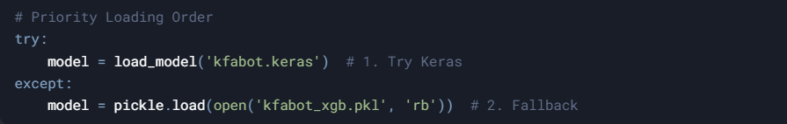
Production Loading
Code Flow:
Dependencies:
TensorFlow/Keras or scikit-learn
NLTK for text preprocessing

Slide 32
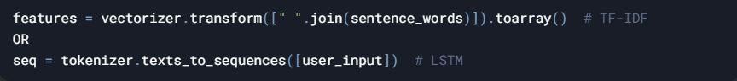
Prediction Pipeline
Step-by-Step:
Preprocess Input:
Feature Extraction
Generate Response

Slide 33
Output Handling
Context Integration:
Fallback Trigger:

Slide 34
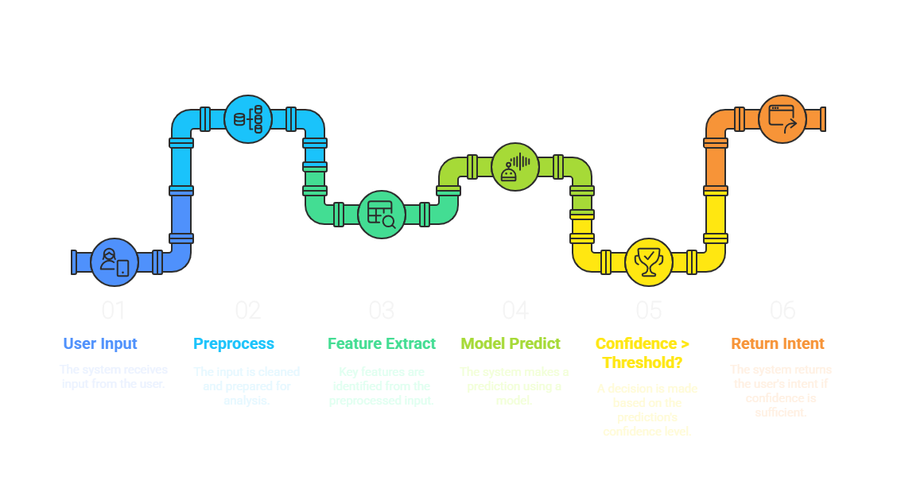
Flow Diagram

Slide 35
THANK YOU

